Slide 1
Group Bravo
Andrew Reeson & Marlene Fuller

Slide 2
Case Study: Outland Adventures
Two outdoor enthusiasts that started a side hustle arranging guided trips while providing the equipment needed for those that need to rent or buy.
Two guides: John MacNell & D.B. Marland
Marketing Specialist: Anita Gallegos
Supplies & Equipment Operations: Demitrios Stavopolous
Web Developer: Mei Wong

Slide 3
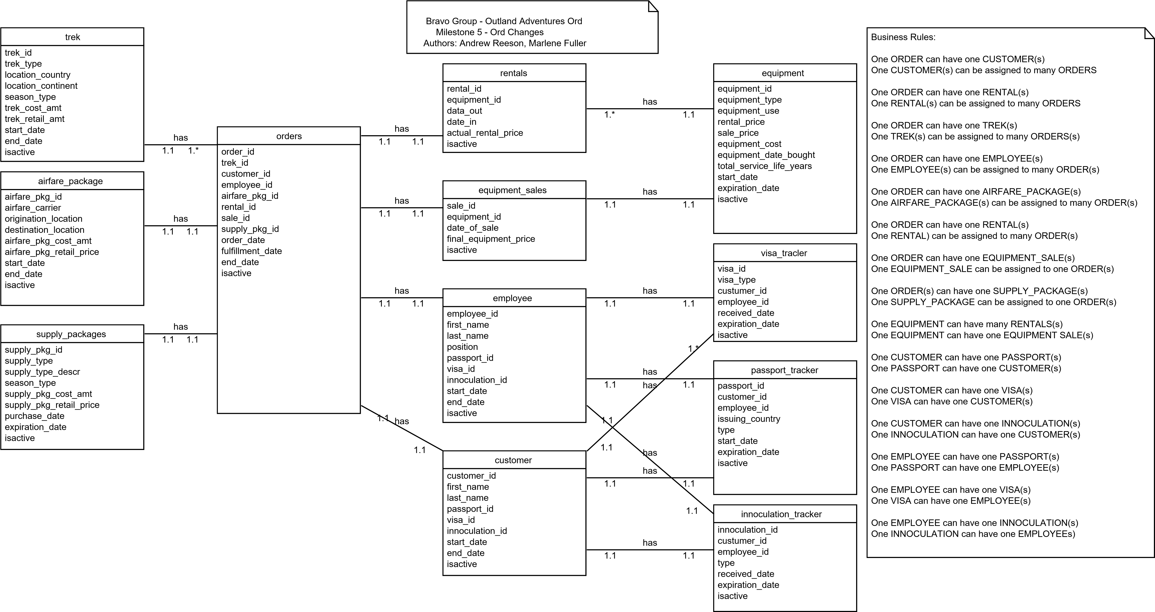
ORD

Slide 4
Report 1 & Strategy
Question: Do enough customers buy equipment to keep equipment sales?
Our first report was created to shed light on whether there were enough sales over the last few years to decide whether it was worth keeping equipment sales as a business strategy.
To do this week looked at the data from the Equipment Sales table and the Equipment table.

Slide 5
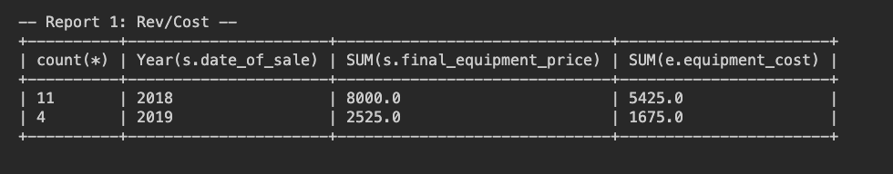
Report 1
Count(*) = the amount of sales that year
Year(s.date_of_sale) = Data from that specific year
SUM(s.final_equipment_price) = Sum of all equipment sales revenue
SUM(e.equipment_cost) = sum of all equipment sales costs
Together we can quickly analyze how many equipment sales have been made over the years 2018 & 2019. Which does give reason to why they were wondering if it is worth it to keep their equipment sales as part of their business strategy.

Slide 6
Report 2 & Strategy
Question: So far, they have conducted treks in Africa, Asia, and Southern Europe. Is there anyone of those locations that has a downward trend in bookings?
With our second report we focus in on the location of the treks, how many customers “ordered” that location and what year that trek occurred. With this data we can look at data trends to determine which locations were most successful.

Slide 7
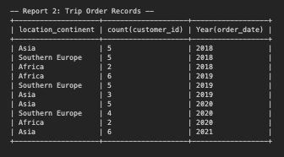
Report 2
With this report we can look at how each continent did for the years 2018 through part of 2021. The stats show that the bookings for Africa is quite volatile. In 2018 Africa had the least, in 2019 it had the most, then yet again the least in 2020. Southern Europe has been semi consistent through the years and Asia has been fairly consistent as well, except for a slight dip in 2019.

Slide 8
Report 3 & Strategy
Question: They are a little concerned about the age of some of the inventory. Are there inventory items that are over five years old?
Here we were able to pull a report from our Equipment table to look at the equipment type and that equipment’s expiration date. A simple checklist seemed like a more than efficient way to check on this.

Slide 9
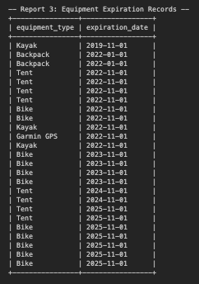
Report 3
With a quick glance at our Equipment Expiration report, we can see that one of our kayaks is past it’s expiration date. We’ve also got our two backpacks that are coming up on their expiration at the end of the month.

Slide 10
Assumptions
We made quite a few assumptions when setting up the data for this case study. We knew a few locations of their treks but otherwise we had to make assumptions on:
  Equipment for sale/rent
  Sale and rental prices
  Amount of orders
  What the order were for
  Equipment expiration dates
  Many many other small details
All together there were many small assumptions, but the ones listed above were critical for creating the reports.

